Slide 1
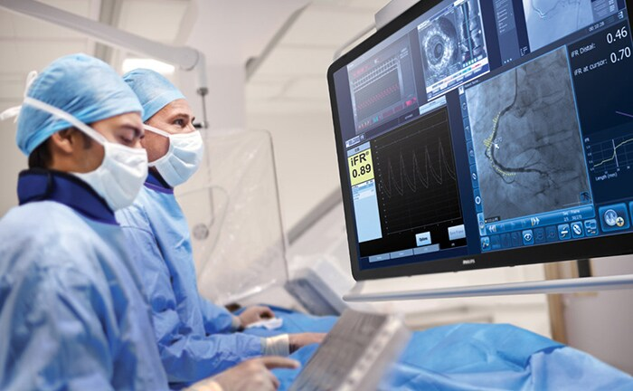
SonoRay
Elevator Pitch
09.05.2022

Slide 2
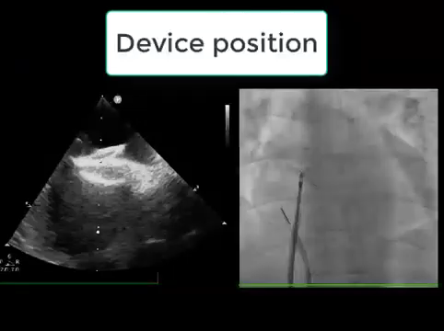
Take the challenge
Notes:
https://www.youtube.com/watch?v=fCia1PFM9Tk

Slide 3

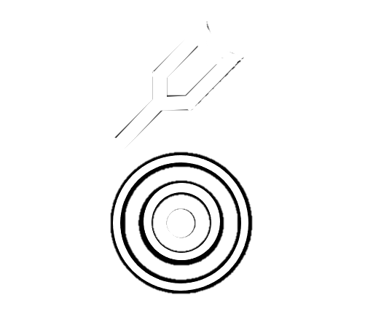

Pains
Interventional Cardiologist
+
ULTRASOUND
X-RAY
Real-time
Soft Tissue
Non-Harmful
Devices
Resolution
Real-time
Devices
Resolution
Soft Tissue
Harmful
-
Notes:
Or Opportunity
Or Customers Pain

Slide 4



Opportunity
ULTRASOUND
X-RAY
Real-time
Soft Tissue
Non-Harmful
Devices
Resolution
Real-time
Devices
Resolution
Soft Tissue
Harmful
Notes:
Or Gain Creators
Or Gain Creators & Pain Relievers

Slide 5
Pain Relievers
Interventional Cardiologist
Overlaid Ultrasound & X-Ray Images
Reduced Harmful Radiation
Assisted Image Guidance
Notes:
Or Gain Creators
Or Gain Creators & Pain Relievers

Slide 6
Product
Interventional Cardiologist
Overlaid Ultrasound & X-Ray Images
Dynamic Fusion Imaging
Reduced Harmful Radiation
Fluoroscopy Frames Interpolation with Adaptive Frame Rate
Assisted Image Guidance Annotation Points & Labels
Notes:
Or Gain Creators
Or Gain Creators & Pain Relievers

Slide 7
Vision
Our vision is to get the most out of these modalities:
FROM COMPLEMENTARY DIVIDED, TO SYNERGISTICALLY UNITED
Notes:
Joining information sources to reduce mental load for the doctor
Full integration of information sources … on demand.
Keywords:
Multimodal
On-demand
Realtime
Joining
Image fusion
Information sources

Slide 8
Market
TAM
Catheter-based Procedures
Coronary Intervention
Catheter-based Intracardiac Procedures
50 million per yr
50-500 billion $
TEE
ICE
TTE
SAM
ICE-assisted
Catheter-based
Intracardiac Procedures
SOM
30%
10 million per yr
10-100 billion $
Notes:
50 106 * 1 103
50 106 * 104
1million : 329,5 million = x : 7,9 billion
24 million procedures per year
Almost 3 thousands in 1 hr
Catheterization laboratory is 1,250 cases per year, based on five procedures per day for 250 days. (https://hca.wv.gov/certificateofneed/Documents/CON_Standards/CardiacCath.pdf)
Cardiac Catheterization laboratory : 5 per million of people
(https://www.escardio.org/The-ESC/Press-Office/Press-releases/Report-of-interventional-cardiology-practice-presented-in-first-extensive-survey)
transesophageal echocardiography (TEE) : Guiding management of catheter-based intracardiac procedures (including septal defect closure or atrial appendage obliteration, and transcatheter valve procedures).
https://www.asecho.org/wp-content/uploads/2014/05/2013_Performing-Comprehensive-TEE.pdf
Intracardiac echocardiography (ICE) is a relatively new echocardiographic technique, essentially used for monitoring of percutaneous atrial septal defect closure procedures (most common congenital heart lesion in adults.) and for electrophysiological catheter-based ablations.
60,000 catheter ablation procedures are performed per year in Germany
60000 : 83,4 million = x : 7,9 billion → x ~6million
https://www.sciencedirect.com/science/article/pii/S2405500X1830015X
https://academic.oup.com/eurheartj/article/38/17/1303/2926204?login=true
80 procedures catheter-based closure of septal defect per center
5 million of centers per million of people
80*5*7900 = 3,16 million

Slide 9
Go-To-Market Strategy
In-silico Prototype
Pre-Product Prototype
Pre-Product
FDA Approval
Pre-Product
Market Launch
In-vivo Data Acquisition
Technology Development ​
Clinical Research
Full Product
Market Launch
2022
2023
Investment Round
2024
2025
2026
2027
2028
In-silico Data Acquisition
Technology Development
In-vivo Data Acquisition
Clinical Research
Technology Development ​
Business Idea
Partnership
MedTech Company
Full Product Prototype
Full Product
FDA Approval
Notes:
Add dates below , then blocks above
Add a short sentence about in-silico to explain what is it and why is there
2 lines from partnership with medtech: one for low-hanging fruit (processing software) [early on generate revenue] and one for a full prototype (full integration)

Slide 10
Development plan
End goal:
Full image fusion of X-ray and US data.
Reduce harmful radiation
Improve workflow of clinician
Roadblocks
Development of novel (AI) algorithms
Validation of new technologies
Limited data availability

Slide 11
Development plan
Step 1:
Frame interpolation of X-ray video data
Feasibility of image reconstruction with gaps in data. (framerate mismatch)
Reduction in amount of radiation
Stand-alone product for early revenue stream
Step 2:
Variable framerate X-ray
Adjust framerate based on movement
Extract dynamics using US probe
Step 3:
Simulation setup
X-ray and US simulation environment
Image fusion in in-silico setup
End goal:
Full image fusion of X-ray and US data.
Reduce harmful radiation
Improve workflow of clinician

Slide 12
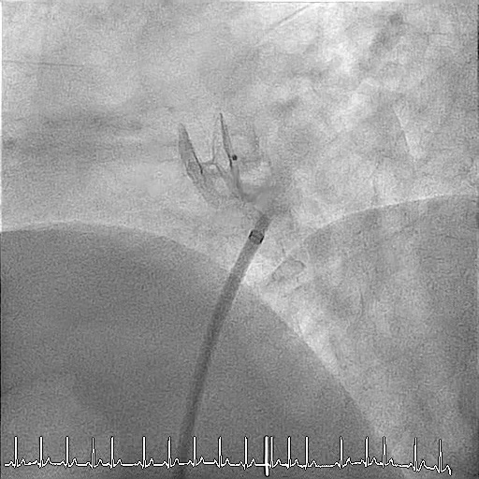
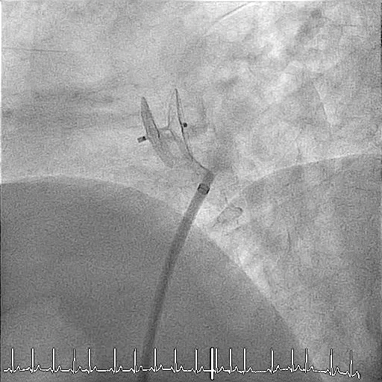
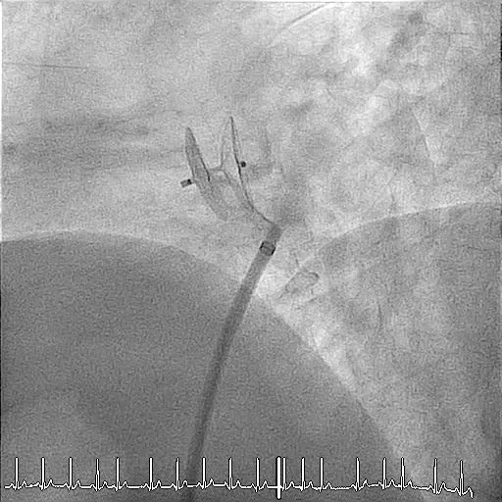
Step 1: Frame Interpolation
Frame 1
Frame 2
Frame 3
Frame 4
Frame 5
Frame 6
Frame 7
Frame 8
Frame 2
Frame 3
Frame 4
Frame 5
Frame 6
Frame 7
Frame 8
Frame 1
Step 1:
Frame interpolation of X-ray video data
Feasibility of image reconstruction with gaps in data. (framerate mismatch)
Reduction in amount of radiation

Slide 13
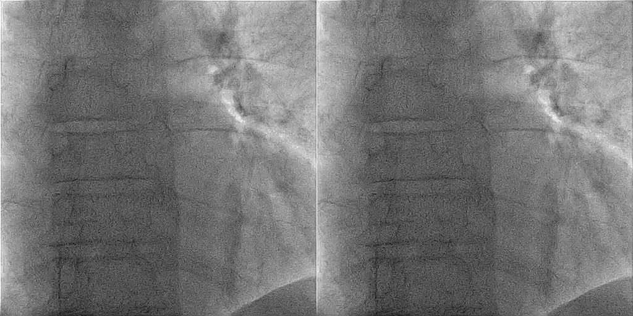
Step 1: Frame Interpolation
Original video 30 fps
AI enhanced 7.5fps video (4 times ↓)

Slide 14
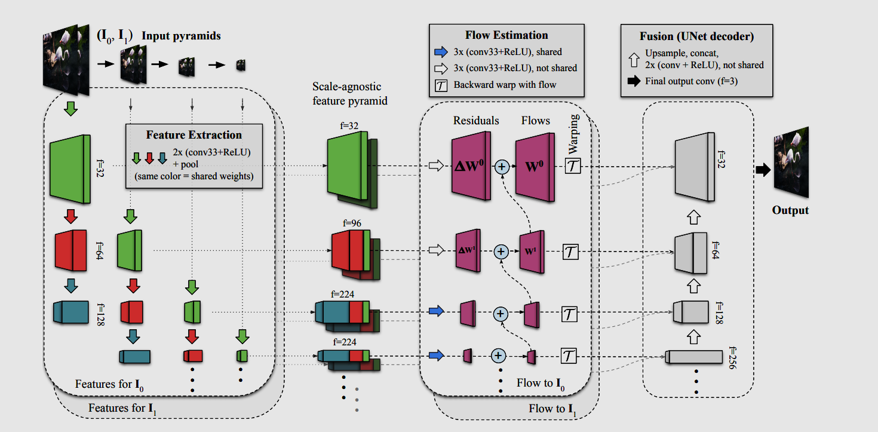
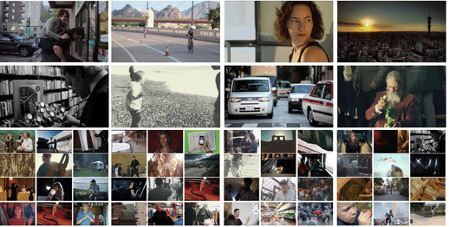
Step 1: Frame Interpolation
Architecture based on Google’s FILMnet
Training in natural videos:
Vimeo-90K dataset
Future goals:
Model-based structure → exploit temporal redundancy
Train on true X-ray data

Slide 15
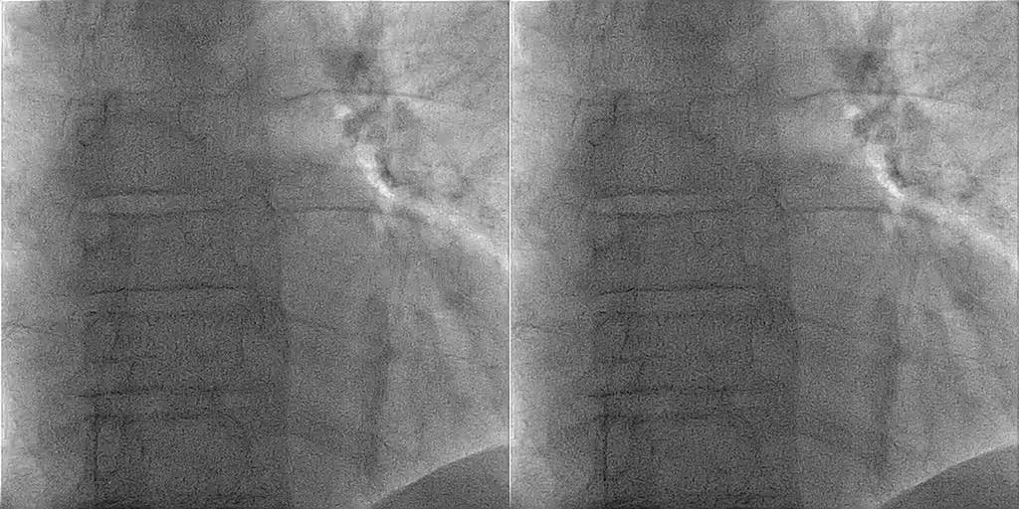
Step 1: Frame Interpolation
Original video 30 fps
AI enhanced 1fps video (32 times ↓)

Slide 16
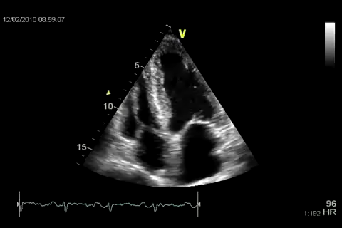
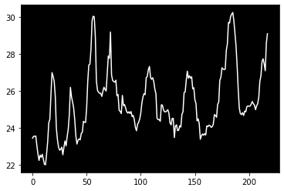
Step 2: Variable framerate
Step 2:
Variable framerate X-ray
Adjust framerate based on movement
Extract dynamics using US probe

Slide 17
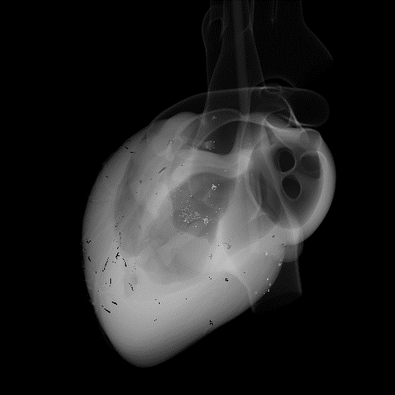
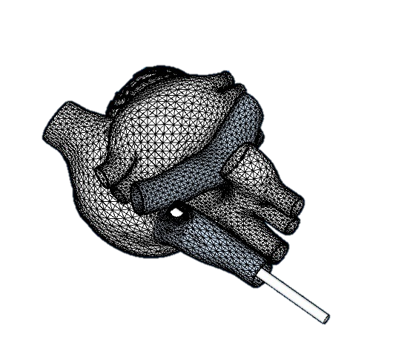
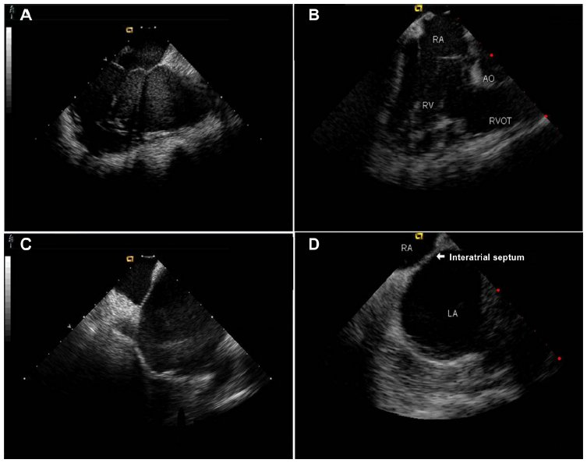
Step 3: Simulation
X-ray simulation
Step 3:
Simulation setup
X-ray and US simulation environment
Image fusion in in-silico setup
X-ray sim
CAD model
ICE simulation
US sim

Slide 18
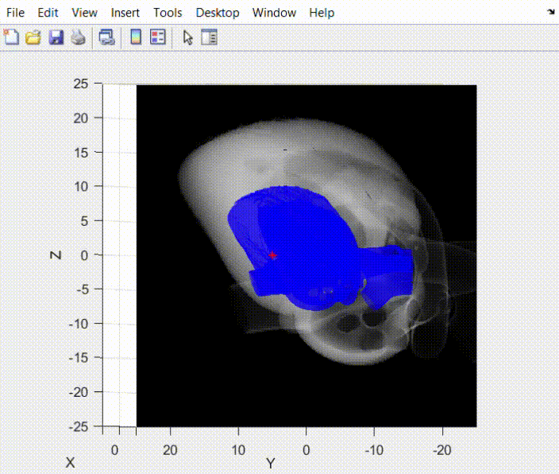
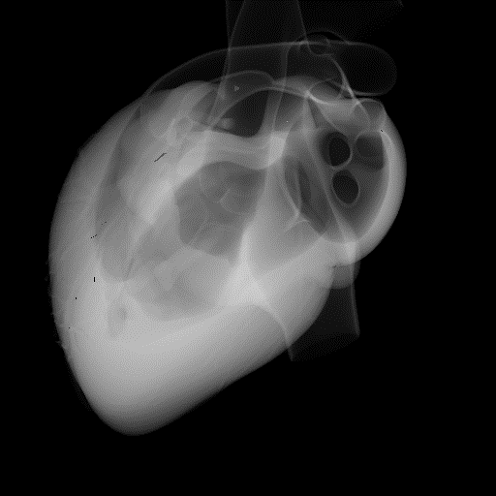
Step 3: Simulation
ICE probe
Simulation based on ray-casting

Slide 19




Investments
1.2 M $
for first 2 yrs
TEAM EXPENSES
PRODUCT DEVELOPMENT
Retrain frame interpolator on X-ray data
Joint motion detection + framerate adjustment
Data simulation (licenses) and acquisition
IP AND MARKETING
Notes:
100.000*4*2yrs = 800.000
Licenses & compute powering/server = 50.000 * 2yrs = 100.000
IP 80.000*2 ~200.000 rough estimates for 2-3 patents

Slide 20
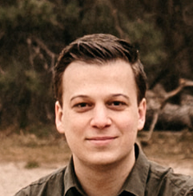
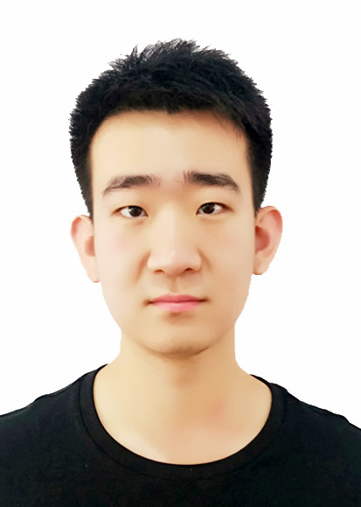
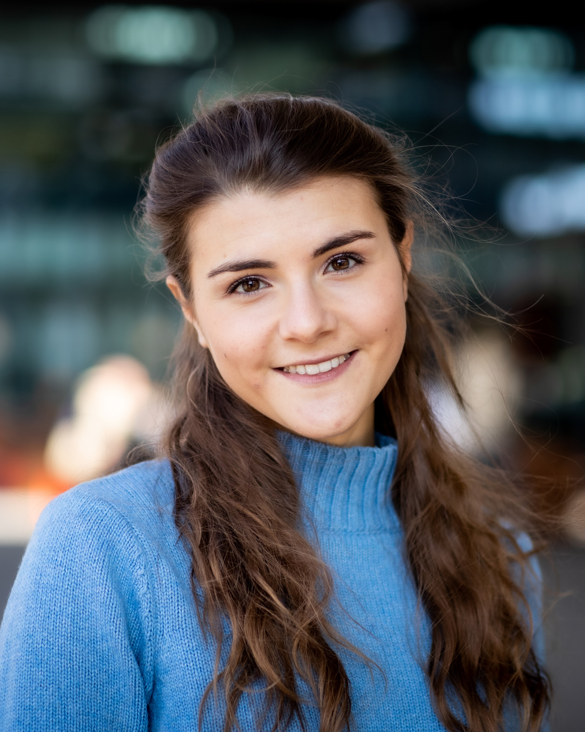

Team
Ben Luijten
AI Engineer
Chen Liang
Electrical Engineer
Beatrice Federici
System Engineer
Shiqi Liao
Data Scientist

Slide 22





Competitor Analysis
Integration of ultrasound and x-ray modalities
PHILIPS
Integration of ultrasound(TEE) and x-ray modalities.
Live 3D TEE and live x-ray smart-fusion tech.
GEN ELECTRIC
A mammography system which uses x-ray to guide the first position of ultrasound receiver.
FISCHER IMAGING
An integrated x-ray and ultrasound medical imaging system which is accomplished by scanning movement of radiation detection means and ultrasound transducer along the same path.
SINO MEDICAL DEV
System and method for three-dimensional breast X-ray and three-dimensional color Doppler ultrasound fusion imaging
FUS MOBILE
Systems and methods for aiming and aligning of a treatment tool within an x-ray device or an ultrasound device environment.

Slide 23

Competitor analysis
4d ICE
Versight-pro
ICE
EPIQ-CVx
Fused TEE and X-ray
EchoNavigator

Slide 24
Market
TAM
Catheter-based Procedures
TTE
Coronary Intervention
TEE
50 million per yr
Catheter-based Intracardiac Procedures
ICE
SAM
ICE-assisted
Catheter-based
Intracardiac Procedures
SOM
30%
10 million per yr
Notes:
1million : 329,5 million = x : 7,9 billion
24 million procedures per year
Almost 3 thousands in 1 hr
Catheterization laboratory is 1,250 cases per year, based on five procedures per day for 250 days. (https://hca.wv.gov/certificateofneed/Documents/CON_Standards/CardiacCath.pdf)
Cardiac Catheterization laboratory : 5 per million of people
(https://www.escardio.org/The-ESC/Press-Office/Press-releases/Report-of-interventional-cardiology-practice-presented-in-first-extensive-survey)
transesophageal echocardiography (TEE) : Guiding management of catheter-based intracardiac procedures (including septal defect closure or atrial appendage obliteration, and transcatheter valve procedures).
https://www.asecho.org/wp-content/uploads/2014/05/2013_Performing-Comprehensive-TEE.pdf
Intracardiac echocardiography (ICE) is a relatively new echocardiographic technique, essentially used for monitoring of percutaneous atrial septal defect closure procedures (most common congenital heart lesion in adults.) and for electrophysiological catheter-based ablations.
60,000 catheter ablation procedures are performed per year in Germany
60000 : 83,4 million = x : 7,9 billion → x ~6million
https://www.sciencedirect.com/science/article/pii/S2405500X1830015X
https://academic.oup.com/eurheartj/article/38/17/1303/2926204?login=true
80 procedures catheter-based closure of septal defect per center
5 million of centers per million of people
80*5*7900 = 3,16 million

Slide 25
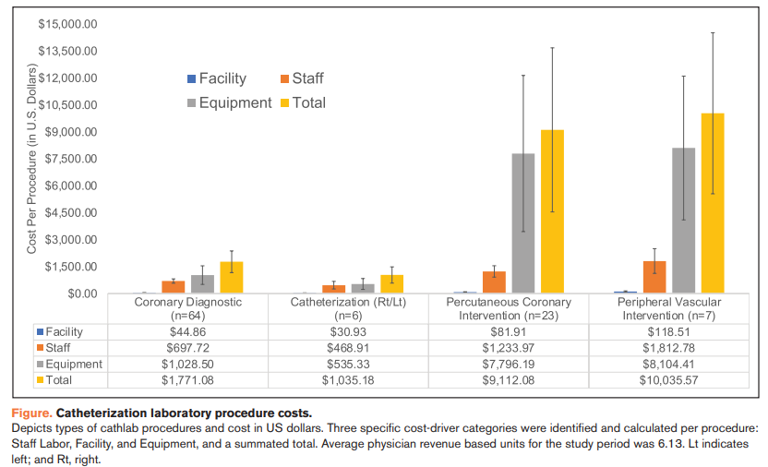
Market
Notes:
1million : 329,5 million = x : 7,9 billion
24 million procedures per year
Almost 3 thousands in 1 hr

Slide 26
Go-To-Market Strategy
In-silico Prototype
Pre-Product Prototype
Pre-Product
FDA Approval
Pre-Product
Market Launch
In-vivo Data Acquisition
Technology Development ​
Clinical Research
Full Product
Market Launch
2022
2023
Investment Round
2024
2025
2026
2027
2028
In-silico Data Acquisition
Technology Development
In-vivo Data Acquisition
Clinical Research
Technology Development ​
Business Idea
Partnership
MedTech Company
Full Product Prototype
Full Product
FDA Approval
Notes:
Add dates below , then blocks above
Add a short sentence about in-silico to explain what is it and why is there
2 lines from partnership with medtech: one for low-hanging fruit (processing software) [early on generate revenue] and one for a full prototype (full integration)

Slide 27
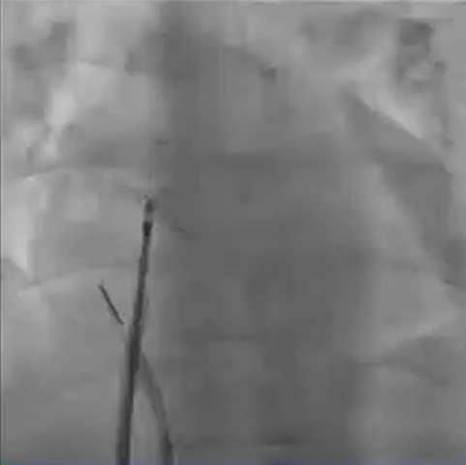
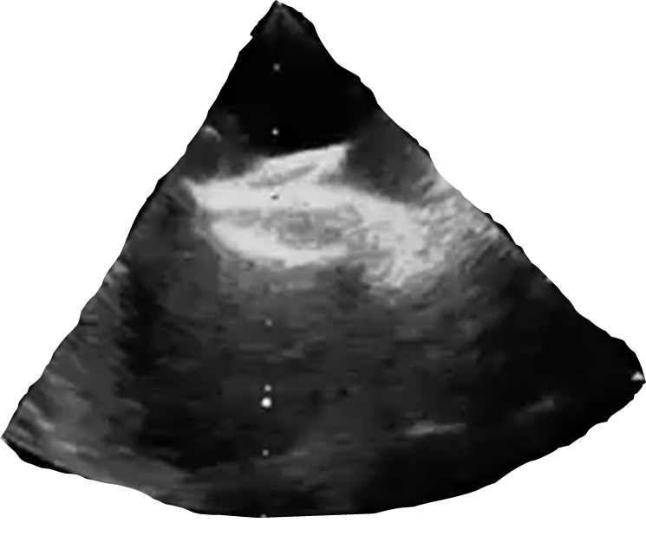
Product & Services
Product:
Interventional Tool
Services:
Customers Assistance 24/7
Technician Training
Notes:
1million : 329,5 million = x : 7,9 billion
24 million procedures per year
Almost 3 thousands in 1 hr

Slide 28
Step 3: Simulation
Step 3:
Catheter
Simulation based on ray-casting

Slide 29
Go To Market Strategy
In-silico Prototype
Pre-Product Prototype
Pre-Product
FDA Approval
Pre-Product
Market Launch
In-vivo Data Acquisition
Technology Development ​
Clinical Research
Full Product
Market Launch
2022
2023
Investment Round
2024
2025
2026
2027
2028
In-silico Data Acquisition
Technology Development
In-vivo Data Acquisition
Clinical Research
Technology Development ​
Business Idea
Partnership
MedTech Company
Full Product Prototype
Full Product
FDA Approval
Notes:
Add dates below , then blocks above
Add a short sentence about in-silico to explain what is it and why is there
2 lines from partnership with medtech: one for low-hanging fruit (processing software) [early on generate revenue] and one for a full prototype (full integration)

Slide 30
Go To Market Strategy
Q1 2022
Business Idea
Q3 2023
In-silico Prototype
Q4 2023
Partnership
MedTech Company
Q4 2025
Full Product
Q4 2027
FDA Approval
Obtainment
Q3 2028
Market Launch
08.04.2022
Investment Pitch
Partner Search
Data Acquisition
Clinical Trials
Notes:
Add dates below , then blocks above
Add a short sentence about in-silico to explain what is it and why is there
2 lines from partnership with medtech: one for low-hanging fruit (processing software) [early on generate revenue] and one for a full prototype (full integration)

Slide 31
Pain Relievers
Interventional Cardiologist
Multi-modality Fusion: Visualize Both Hard & Soft Tissues
Lower Fluoroscopy Frame Rate by Exploiting Ultrasound Information: Reduce Harmful Radiation
Assisted Image Guidance: Project supporting information on the fused images
Notes:
Or Gain Creators
Or Gain Creators & Pain Relievers

Slide 32
Products & Services
Interventional Cardiologist
Multi-modality Fusion: Projection & Registration
Lower Fluoroscopy Frame Rate by Exploiting Ultrasound Information: Fluoroscopy Frames Interpolation with Adaptive Frame Rate
Assisted Image Guidance: Segmentation & Classification
Notes:
Or Gain Creators
Or Gain Creators & Pain Relievers

Slide 33
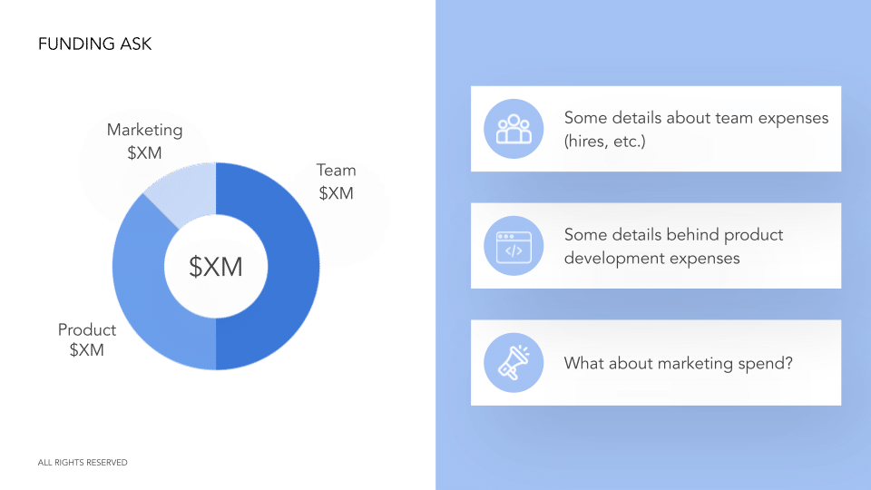
Funding ask
Resources to further development of algorithms
Retrain frame interpolator on X-ray data
Join motion detection + framerate
Data simulation and acquiring real data
Explore IP potential
Expertise to move towards (clinical) deployment
Notes:
-

Slide 34
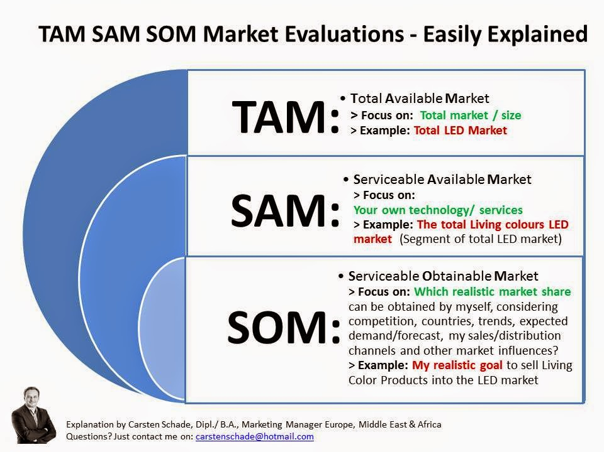
Future markets
Cardiac catheterization
1016000 per year in US
5.0 CathLabs per million people
Structural Heart Disease Intervention
Notes:
https://www.youtube.com/watch?v=fCia1PFM9Tk
file:///C:/Users/20205283/Downloads/CIR.0000000000000757.pdf

Slide 35
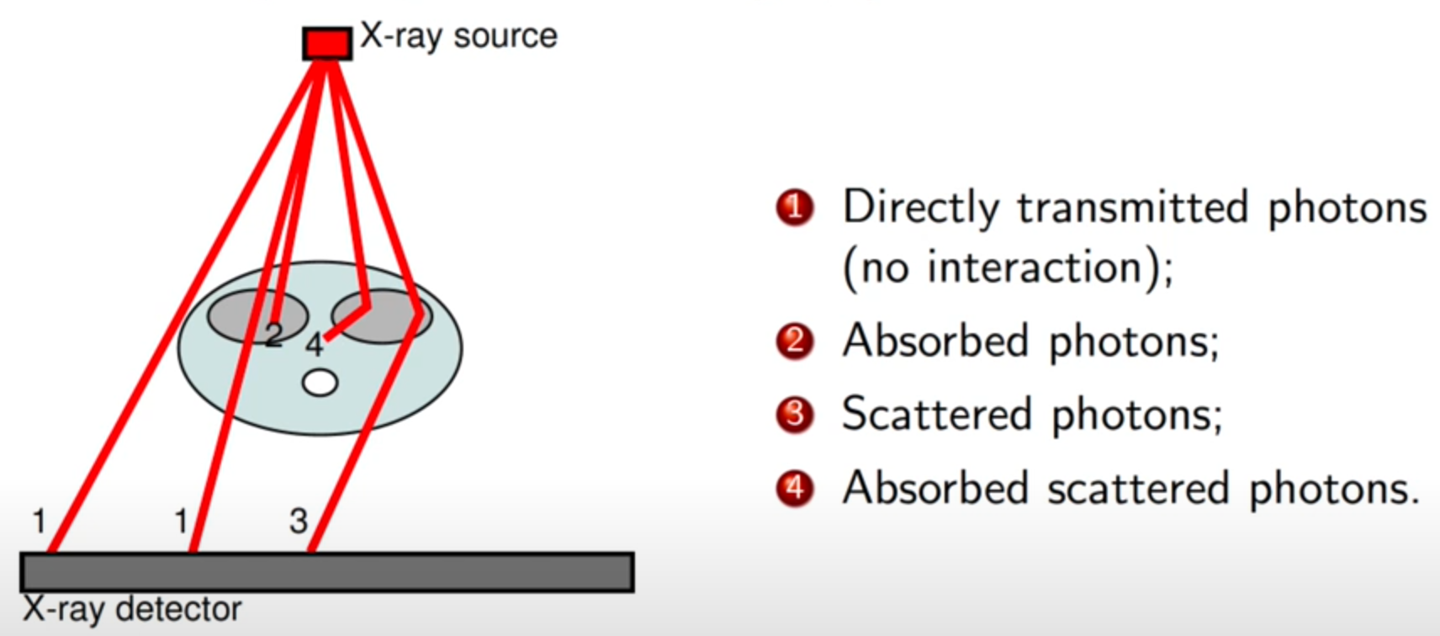
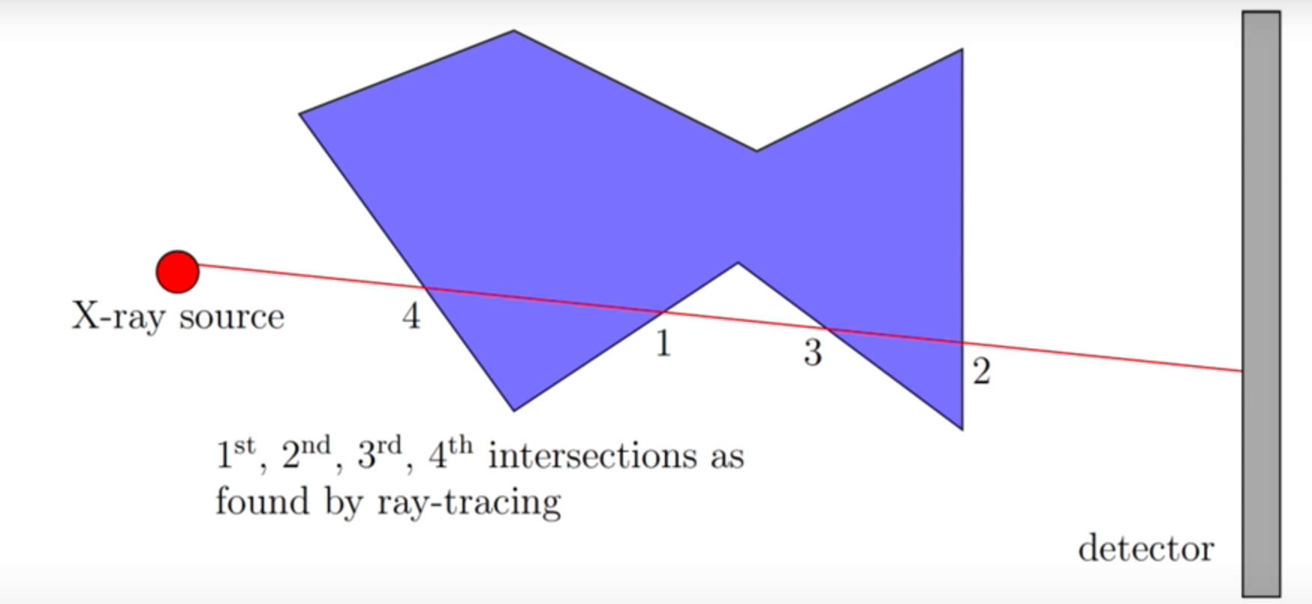
Step 3: Simulation
Data strategy-X-ray
Use raycasting to generate reliable X-ray simulation
Advantages:
Low-cost
Flexible position and shape
High synchronization

Slide 36
Problem
Customer: Interventional Cardiologist
Pains:
Merge Two Images – difficult to navigate – difficult interpretability
Radiation due to Fluoroscopy
Low Image Quality
Notes:
Or Opportunity
Or Customers Pain

Slide 37
Market
TAM
Catheter-based Procedures
Coronary Intervention
50 million per yr
TEE
TTE
Catheter-based Intracardiac Procedures
ICE
SAM
ICE-assisted
Catheter-based
Intracardiac Procedures
SOM
30%
10 million per yr
Notes:
1million : 329,5 million = x : 7,9 billion
24 million procedures per year
Almost 3 thousands in 1 hr
Catheterization laboratory is 1,250 cases per year, based on five procedures per day for 250 days. (https://hca.wv.gov/certificateofneed/Documents/CON_Standards/CardiacCath.pdf)
Cardiac Catheterization laboratory : 5 per million of people
(https://www.escardio.org/The-ESC/Press-Office/Press-releases/Report-of-interventional-cardiology-practice-presented-in-first-extensive-survey)
transesophageal echocardiography (TEE) : Guiding management of catheter-based intracardiac procedures (including septal defect closure or atrial appendage obliteration, and transcatheter valve procedures).
https://www.asecho.org/wp-content/uploads/2014/05/2013_Performing-Comprehensive-TEE.pdf
Intracardiac echocardiography (ICE) is a relatively new echocardiographic technique, essentially used for monitoring of percutaneous atrial septal defect closure procedures (most common congenital heart lesion in adults.) and for electrophysiological catheter-based ablations.
60,000 catheter ablation procedures are performed per year in Germany
60000 : 83,4 million = x : 7,9 billion → x ~6million
https://www.sciencedirect.com/science/article/pii/S2405500X1830015X
https://academic.oup.com/eurheartj/article/38/17/1303/2926204?login=true
80 procedures catheter-based closure of septal defect per center
5 million of centers per million of people
80*5*7900 = 3,16 million

Slide 38
Go-To-Market Strategy
In-silico Prototype
Pre-Product Prototype
Pre-Product
FDA Approval
Pre-Product
Market Launch
In-vivo Data Acquisition
Technology Development ​
Clinical Research
Full Product
Market Launch
2022
2024
2025
2026
2027
2028
Investment Round
2023
In-silico Data Acquisition
Technology Development
In-vivo Data Acquisition
Clinical Research
Technology Development ​
Business Idea
Partnership
MedTech Company
Full Product Prototype
Full Product
FDA Approval
Notes:
Add dates below , then blocks above
Add a short sentence about in-silico to explain what is it and why is there
2 lines from partnership with medtech: one for low-hanging fruit (processing software) [early on generate revenue] and one for a full prototype (full integration)

Slide 39
Go To Market Strategy
Q1 2022
Business Idea
Q3 2023
Prototype
Q4 2023
Partnership
MedTech Company
Q2 2026
FDA Approval
Q1 2027
Market Launch
Elevator Pitch
08.04.2022
Investment
Partner Search
Clinical Trials
Switch to Product
Notes:
Here I would put the development plan

Slide 40
Pain Relievers
Interventional Cardiologist
Multi-modality Fusion: Visualize Both Hard & Soft Tissues
Reduce Fluoroscopy Frame Rate according to Ultrasound Motion Input: Reduce Harmful Radiation
Object Segmentation from Fluoroscopy Image & Projection on Ultrasound Images: Resolution
Notes:
Or Gain Creators
Or Gain Creators & Pain Relievers

